Slide 1
DATA 602-MACHINE LEARNING AND ANALYSIS
DONE BY:
RAHUL KARNATI

Slide 2
PROBLEM OVERVIEW:
According to the dataset considered, this situation deals with violation of laws
and the features related to citations in court from different areas for different people. Most of the times when there is violation of law, the authorities settle it using charges. Few times there are cases where people are charged without committing any violations or there are cases where people resist the charges for an inevitable reason. so in this work, for a citation, we are going to find if the hearing Status is issued or not meaning we are trying to understand how features of citations are affecting people who face any hearing status and people who don't have one. This helps us to know better about the current mindset of people and the mistakes made by them and in-turn provide an analysis for jurisdiction for easy flow of their work.

Slide 3
DATASET FOR THIS PROJECT:
https://data.baltimorecity.gov/datasets/environmental-citations/explore

Slide 4
Proposed work AND STEPS INVOLVED:
Trying to produce an intelligent, analytic solution for above discussed problem Using machine Learning techniques.
STEPS INVOLVED:
Data Acquisition
Data Analysis and Pre-Processing
Removing the columns which are insignificant
Exploratory data analysis
Future Engineering
Data Partitioning
Modelling

Slide 5
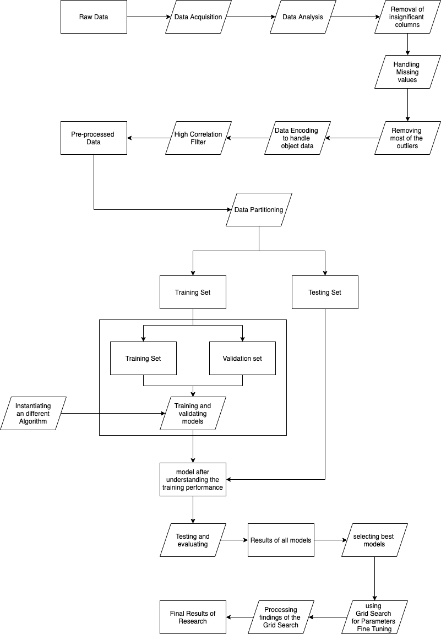
BLOCK DIAGRAM:

Slide 6
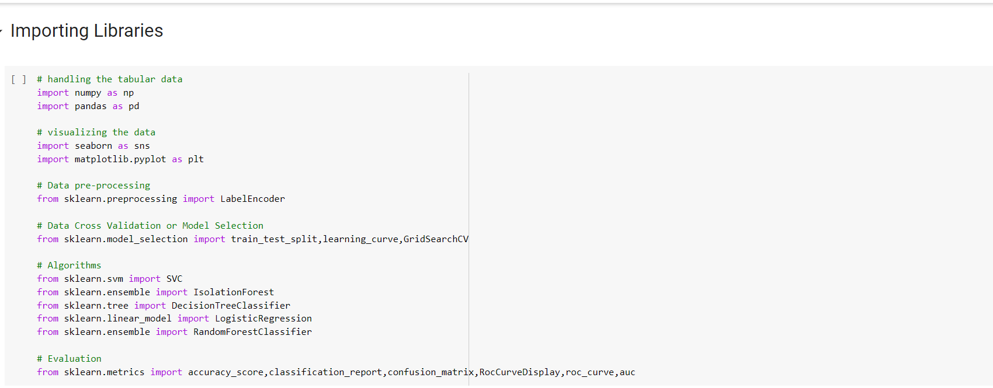
Importing libraries required:

Slide 7
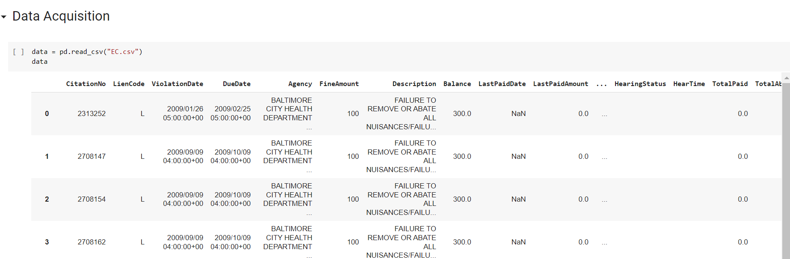
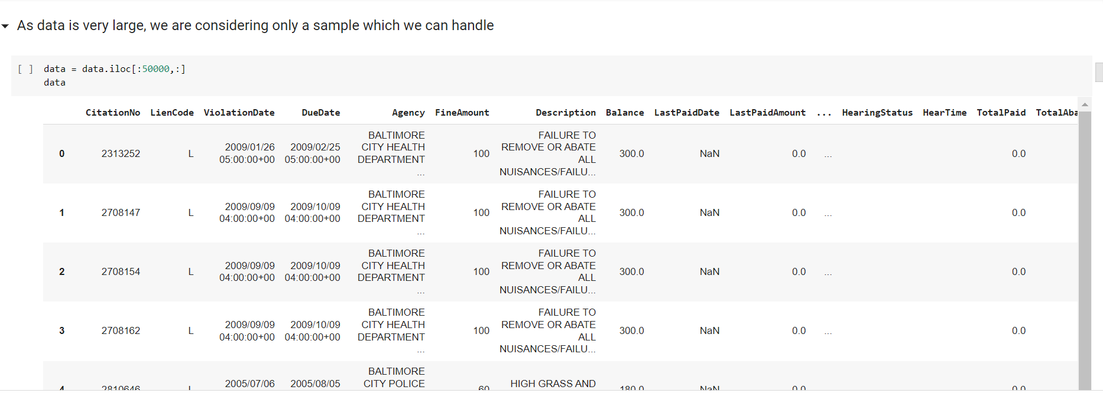
Data Acquisition: converting the normal data like csv file etc. into python understandable data such as nd-array object of numpy or DataFrame object of pandas.

Slide 8
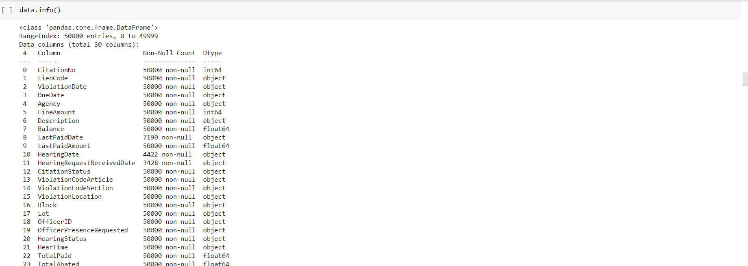
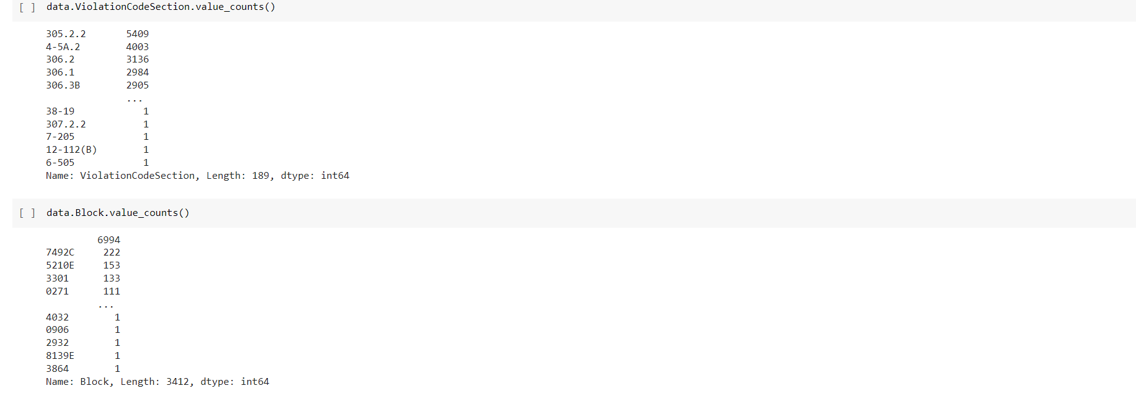
DATA-ANALYSIS: understanding the basics of the data loaded. To have knowledge of number of columns, number of rows, their statistics, correlations etc. So that we can perform Data pre-processing STEP. DATAPREPROCESSING: cleaning the data like removing the empty values, removing insignificant columns, removing outliers, encoding the data or filtering high correlation. preparing the data for giving it as input to the,algorithm,etc.

Slide 9
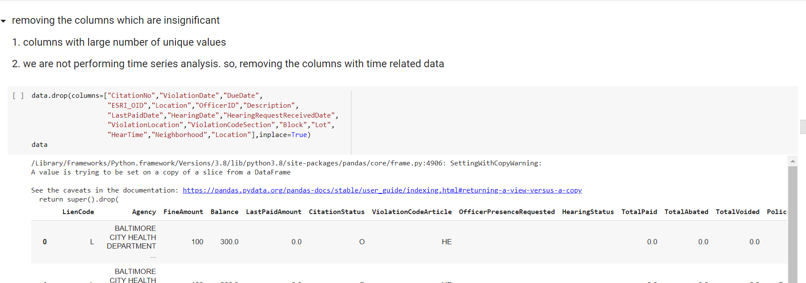
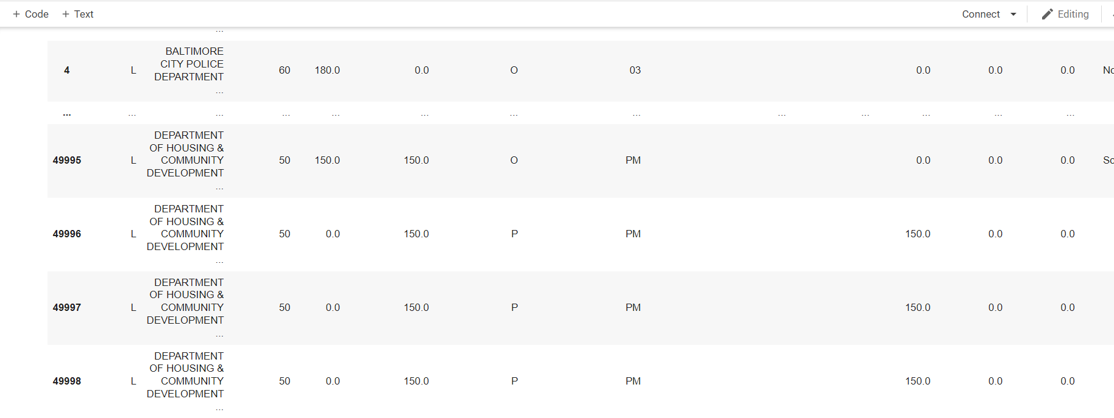

Slide 10
SUMMARY OF DATA ANALYSIS AND PREPROCESSING:
The original dataset has 204161 rows and 30 columns
We are considering only first 50000 rows and 30 columns as population for the research.
As the population has many columns, missing values and outliers. We will be processing the population with many different dimensionality reduction steps as follows
First removal of the columns with large number of categorical values as both one-hot encoding or label encoding will not reduce the dimension or will add bias to data.
Second handling the missing values, as in the population we have missing values in only 2 columns and they are only 0.0044% of the total data. So we will remove the rows with missing values.
In few columns with continuous data, there were outliers which are being removed using Isolation Forest algorithm.
Now object type of data has to be vectorized. Here we are using label encoder to handle columns with moderately high columns

Slide 11
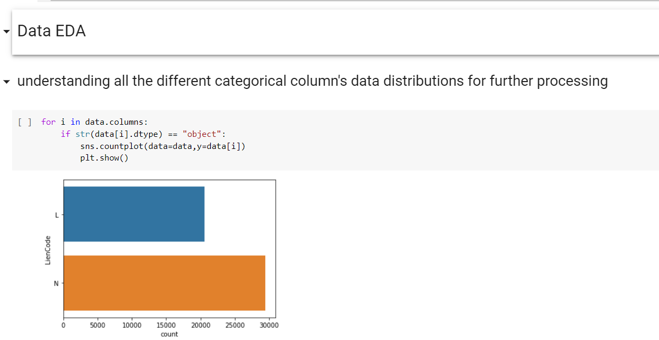
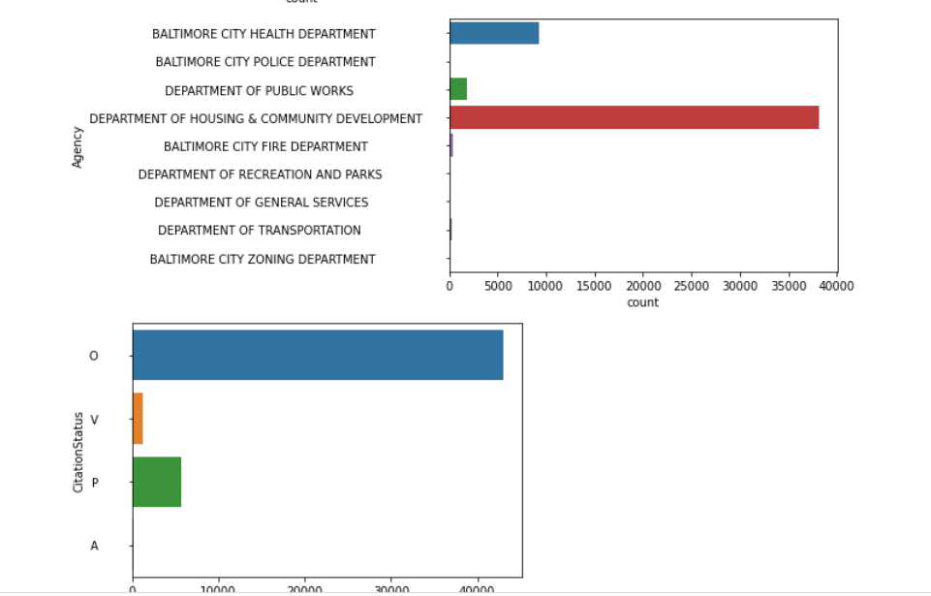
EXPLORATORY DATA ANALYSIS:
Exploratory Data Analysis (EDA) is an approach to analyzing datasets to summarize their main characteristics, often with visual methods. EDA is used for seeing what the data can tell us before the modeling task.

Slide 12
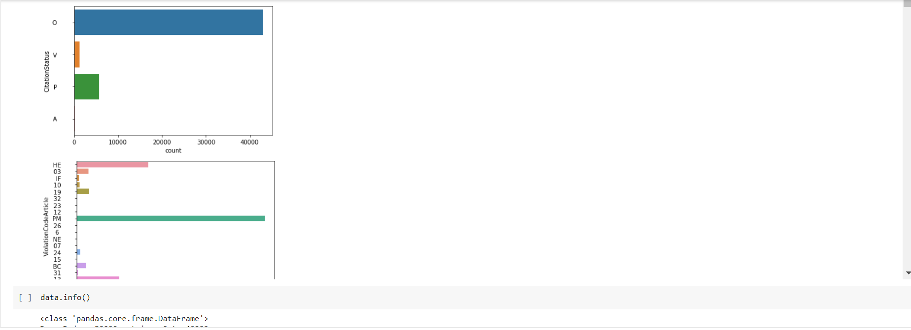
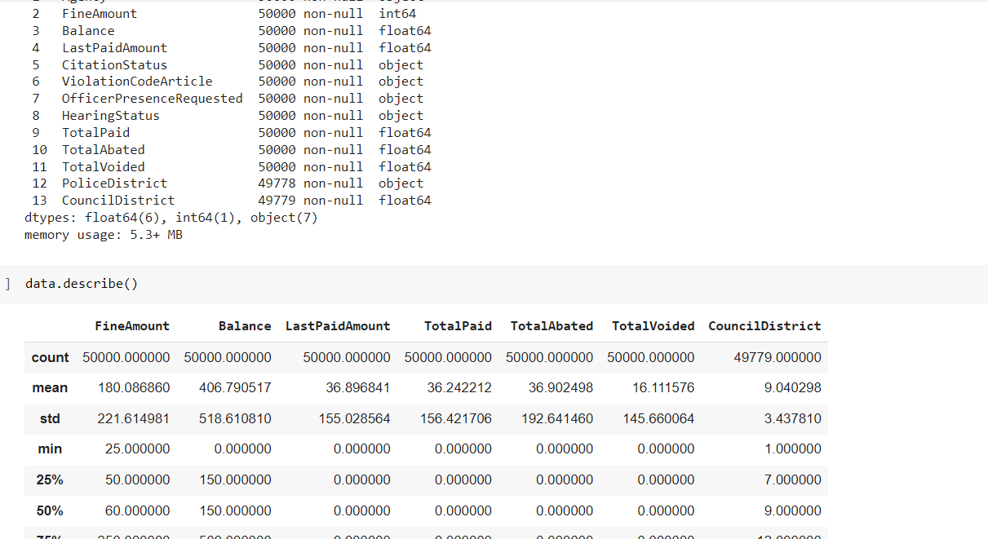
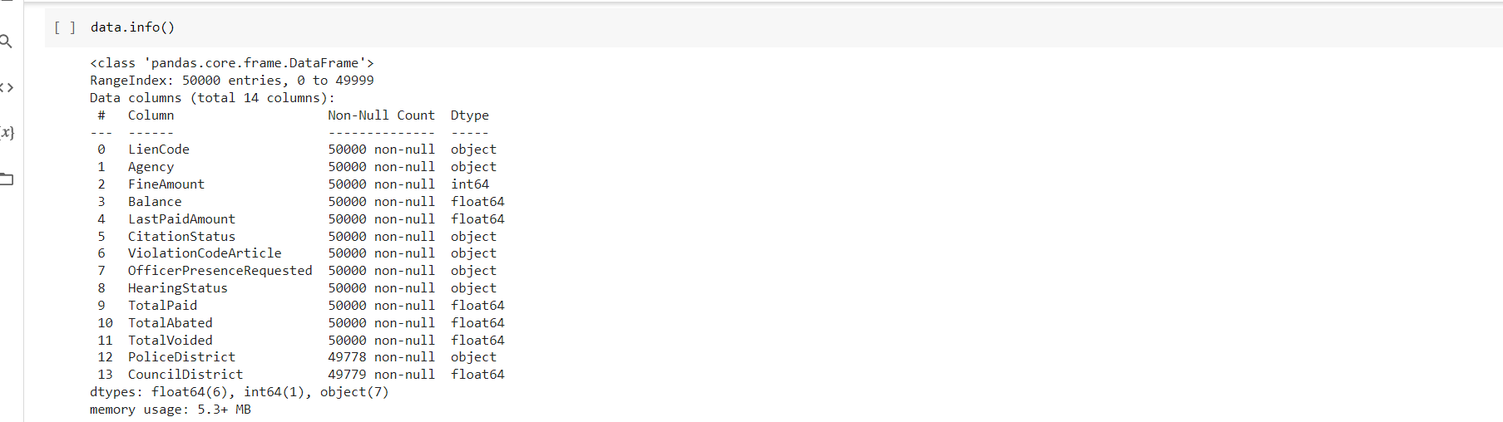

Slide 13
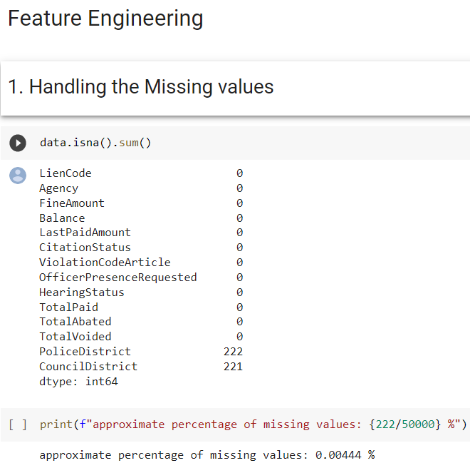
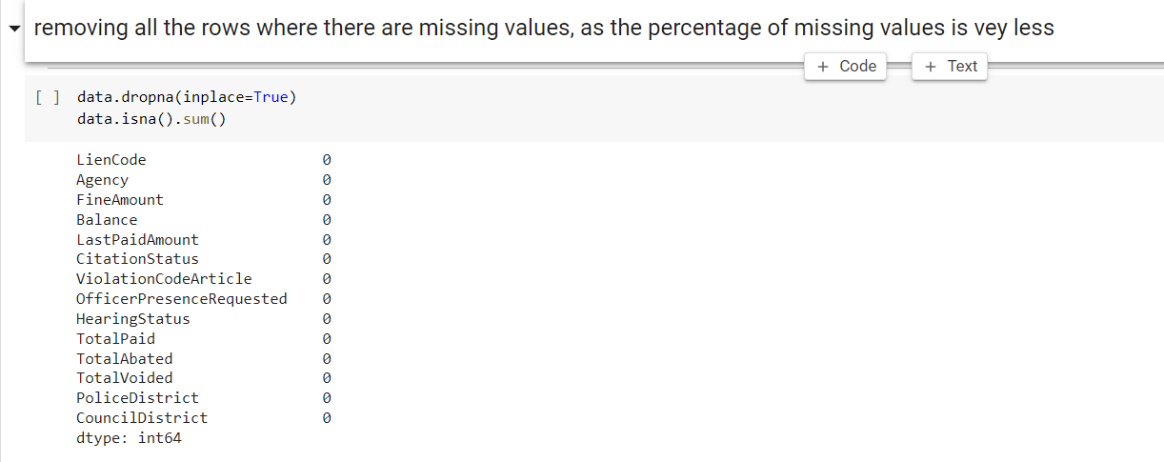
FUTURE ENGINEERING:

Slide 14
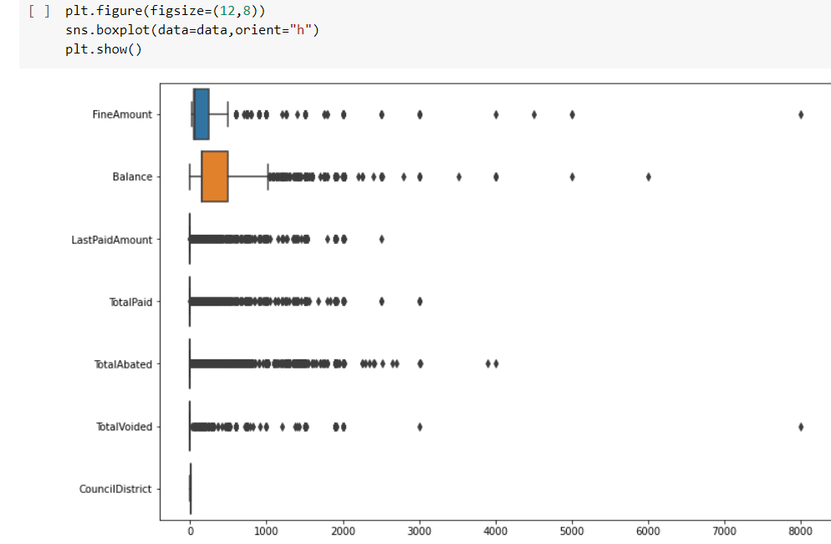
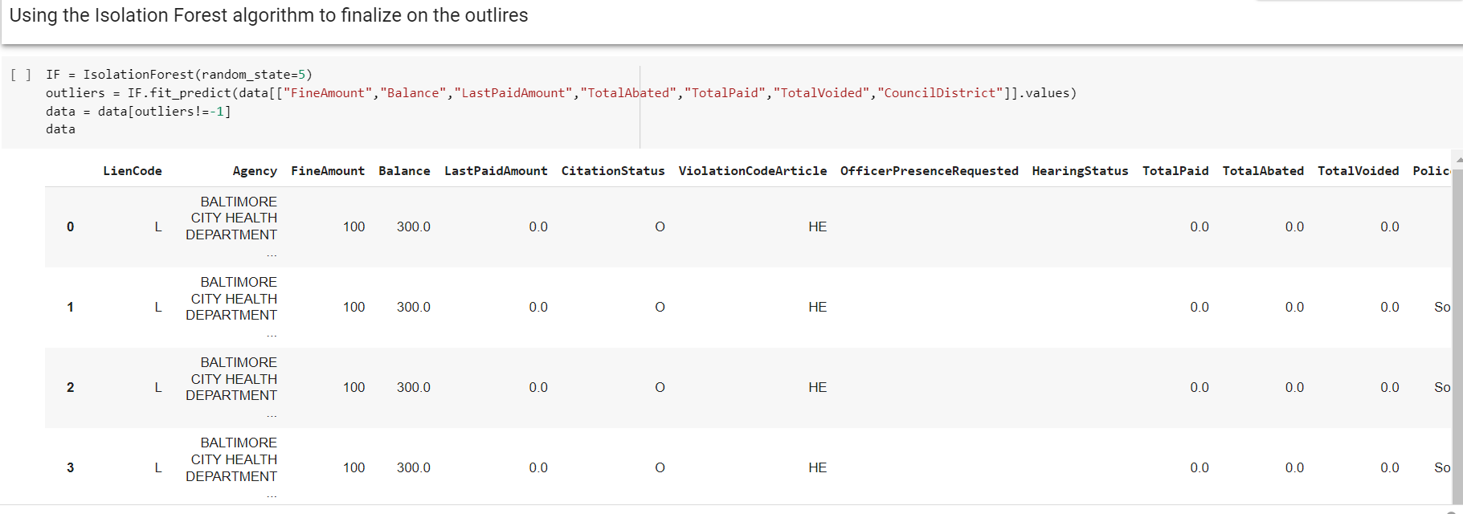
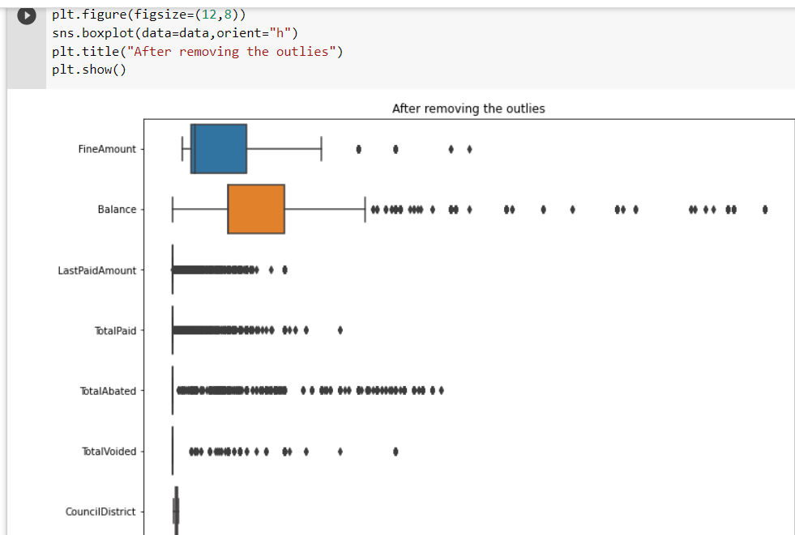
HANDLING OUTLIERS:
Finding outliers through different methods and getting rid of them.

Slide 15
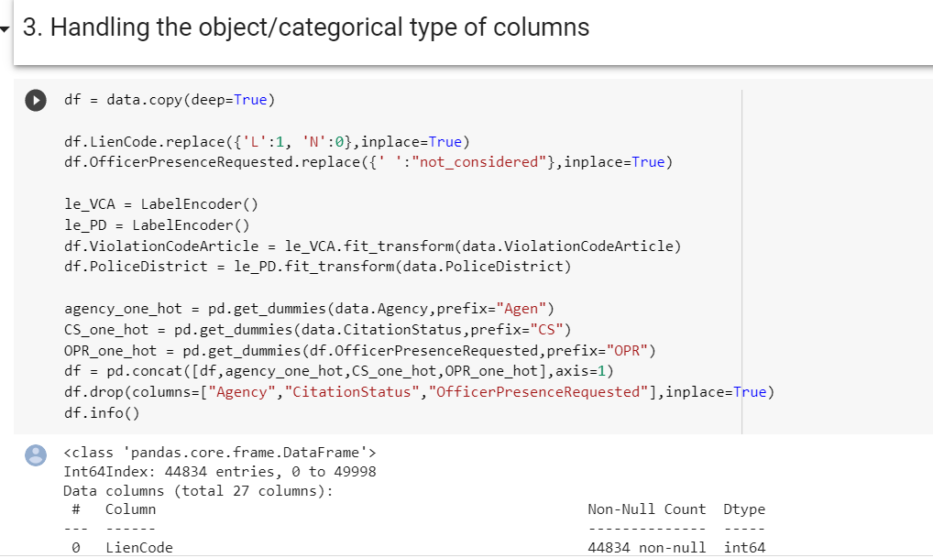
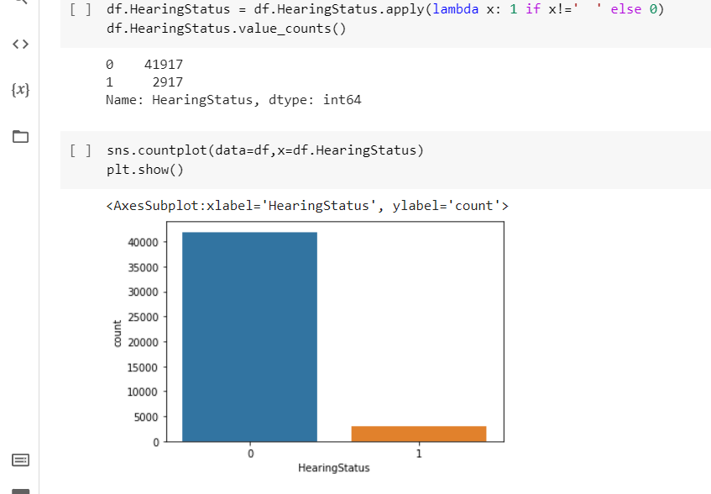
we have
93.49377704420752% negative values
6.506222955792479% positive values

Slide 16
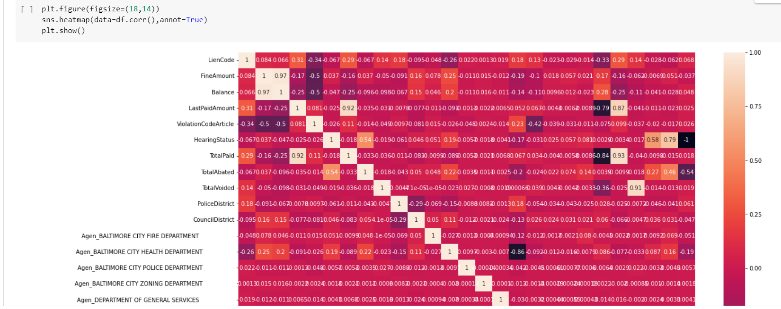
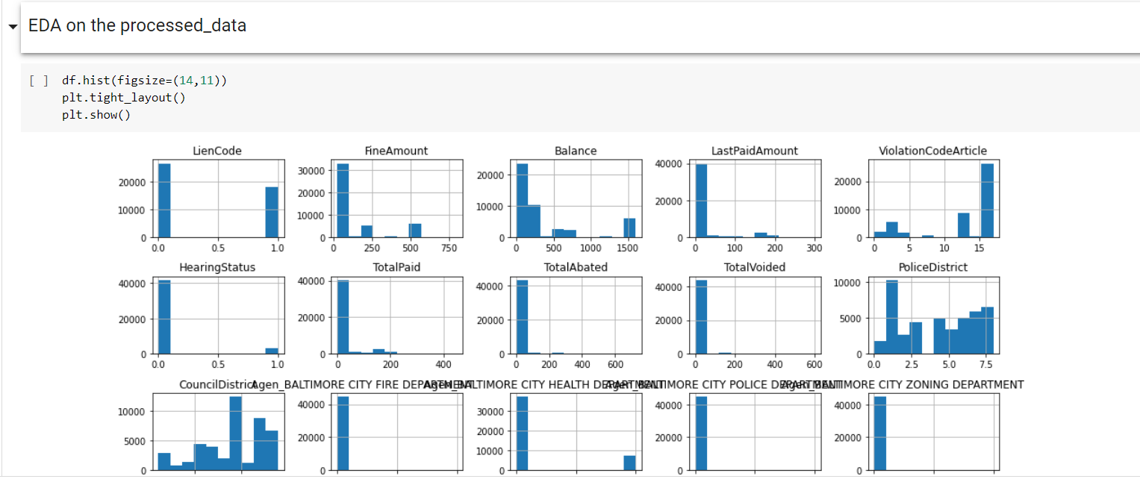
Eda on the processed dataset:

Slide 17
summary of data and pre-processing:
The original dataset has 204161 rows and 30 columns
We are considering only first 50000 rows and 30 columns as population for the research.
As the population has many columns, missing values and outliers. We will be processing the population with many different dimensionality reduction steps as follows
First removal of the columns with large number of categorical values as both one-hot encoding or label encoding will not reduce the dimension or will add bias to data.
Second handling the missing values, as in the population we have missing values in only 2 columns and they are only 0.0044% of the total data. So we will remove the rows with missing values.
In few columns with continuous data, there were outliers which are being removed using Isolation Forest algorithm.
Now object type of data has to be vectorized. Here we are using label encoder to handle columns with moderately high categorical values and using one-hot encoder to handle columns with moderately low categorical values.
After having all the numerical data, now we will filter and remove all the columns with high correlation to reduce the dimensions of data.

Slide 18
Setting the Features and Labels:
selecting the Hearing-Status as label.
so as to predict in which instance people can got to that extent for violation charges.
if a citation has Hearing or not is only considered.
X = df.drop(columns=["HearingStatus"])
y = df.HearingStatus

Slide 19
Data partitioning: We are going with random samples for Training and Testing sets. As in population, we have very less positive values 93.49377704420752% negative values 6.506222955792479% positive values when random state '7' was used for splitting, it has more instances in minority class i.e. more positive values which helps in testing more on minority class In training set, we are having 93.61251289486158% negative values 6.387487105138429% positive values In testing set, we are having 93.0188468830155% negative values 6.9811531169844985% positive values it is observed that both the training and testing set are following the ratios of the population.

Slide 20
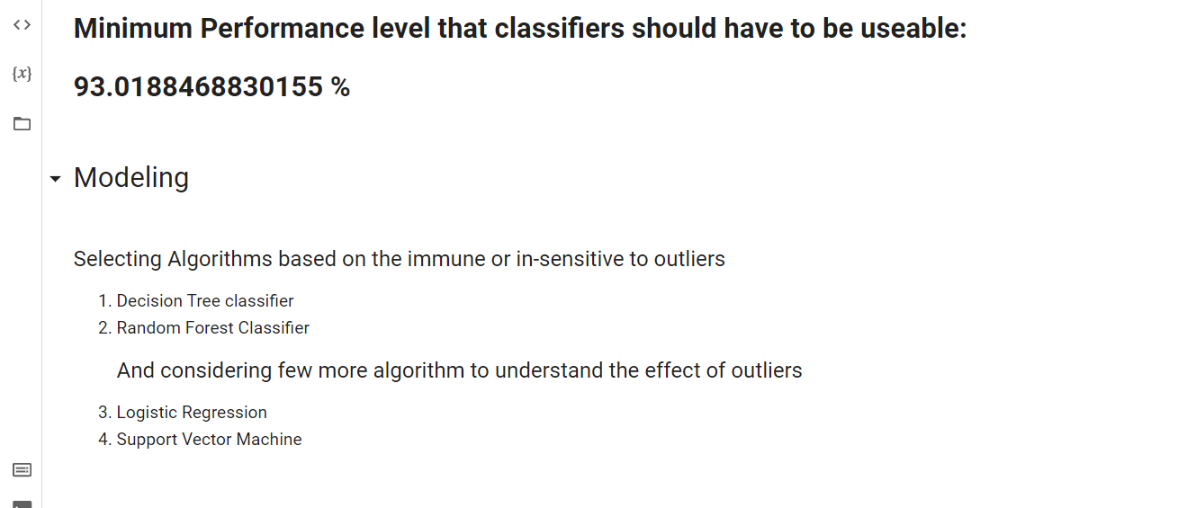
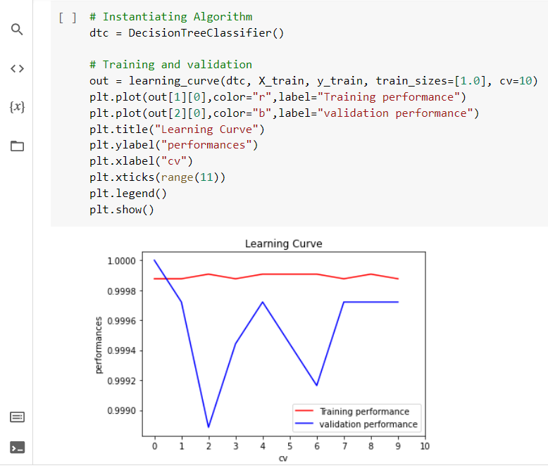
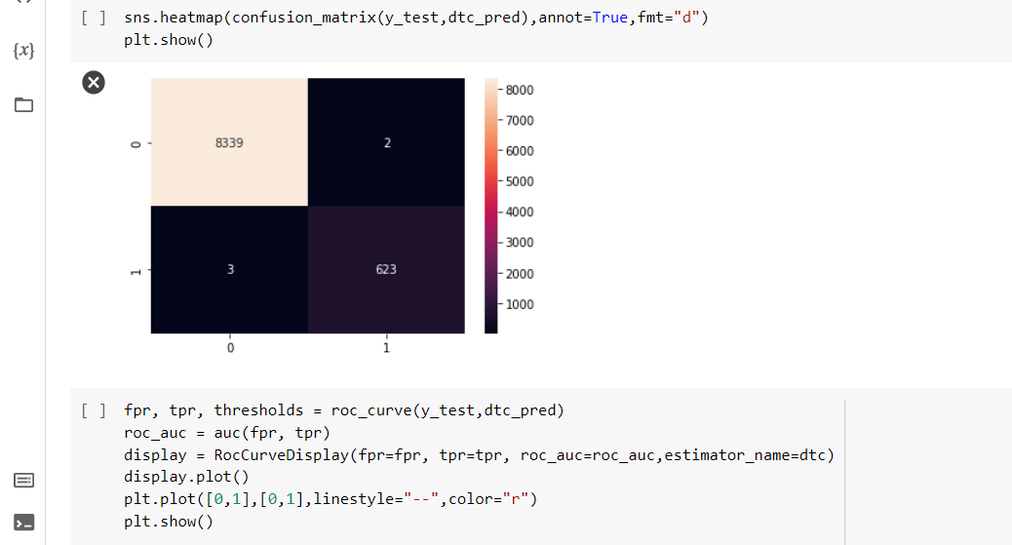
Decision tree classifier:

Slide 21
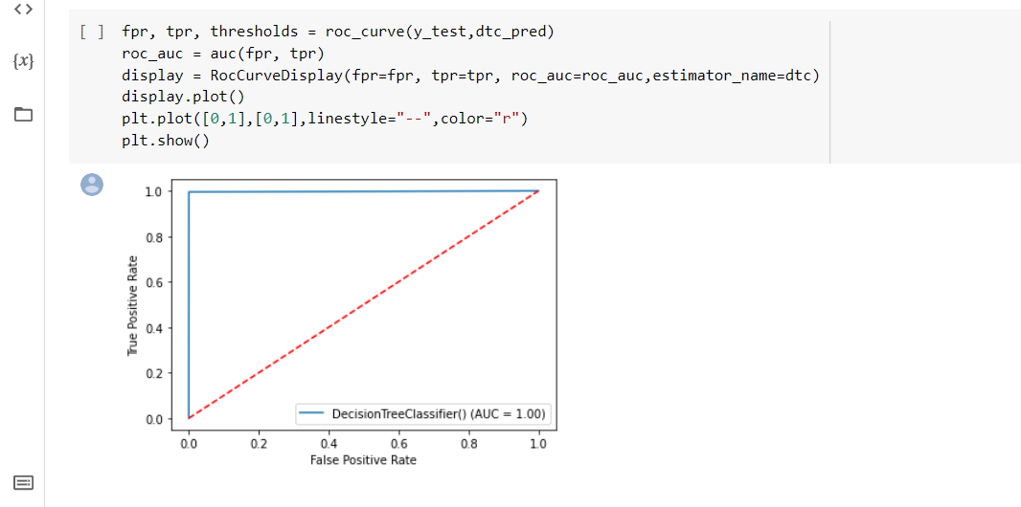
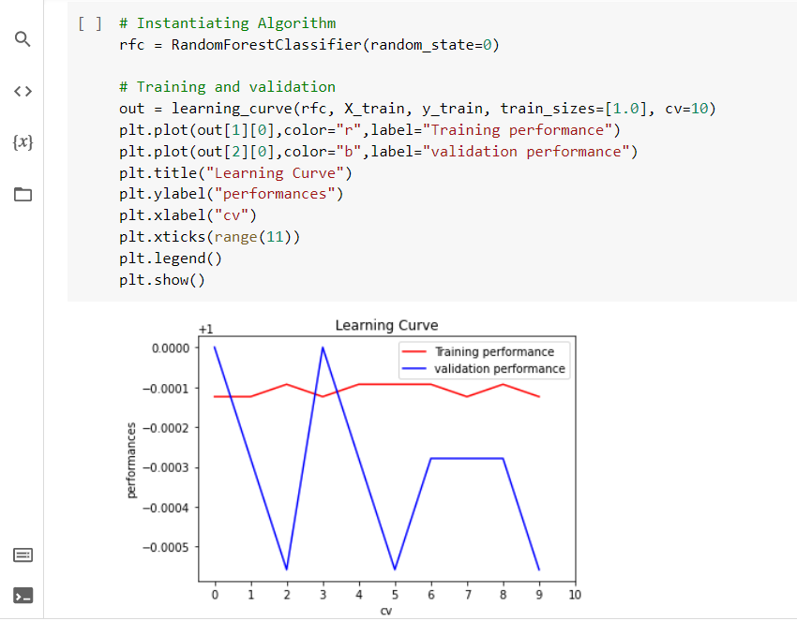
RANDOM FOREST CLASSIFIER

Slide 22
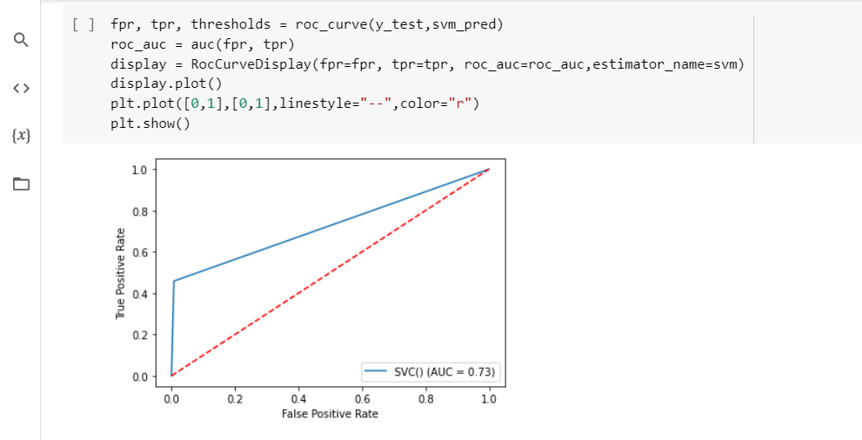
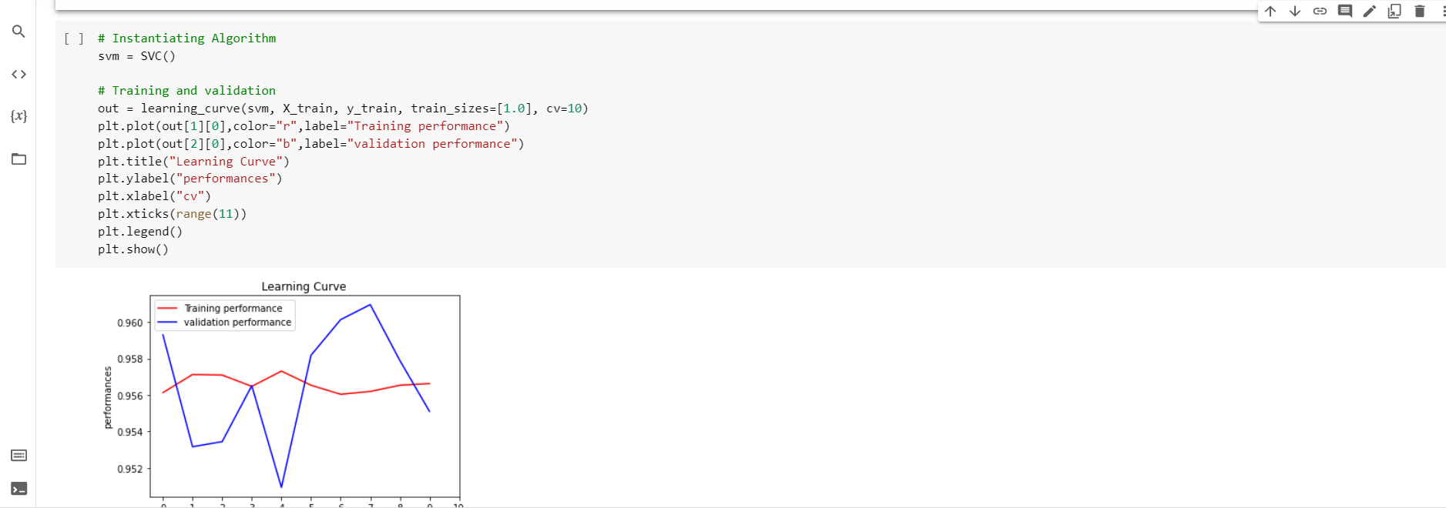
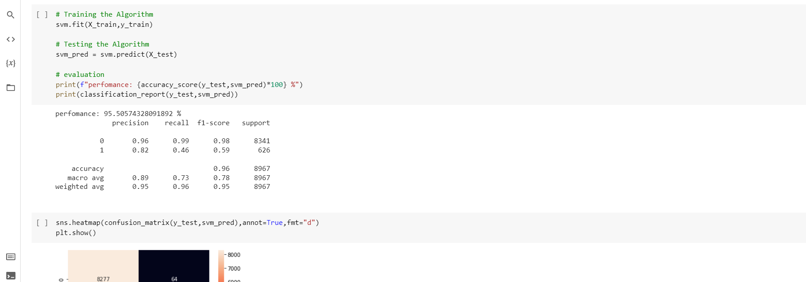
SUPPORT VECTOR MACHINE:

Slide 23
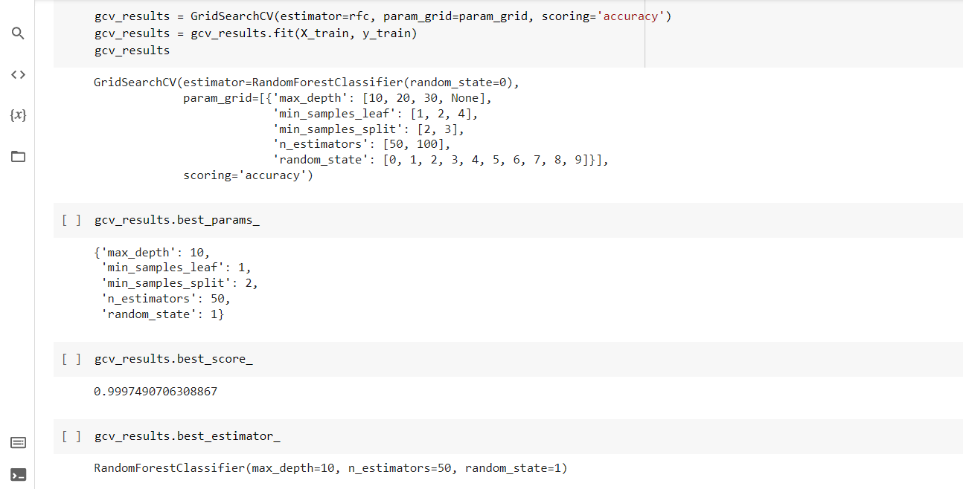
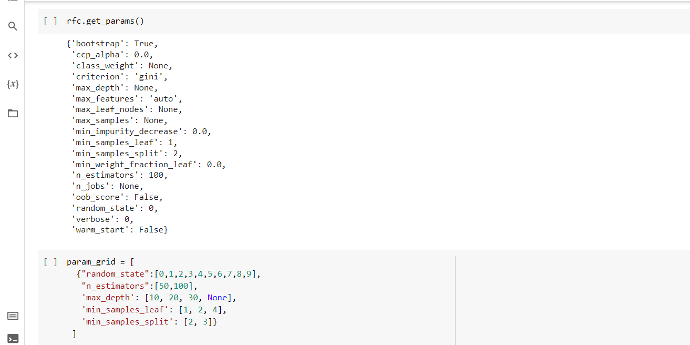
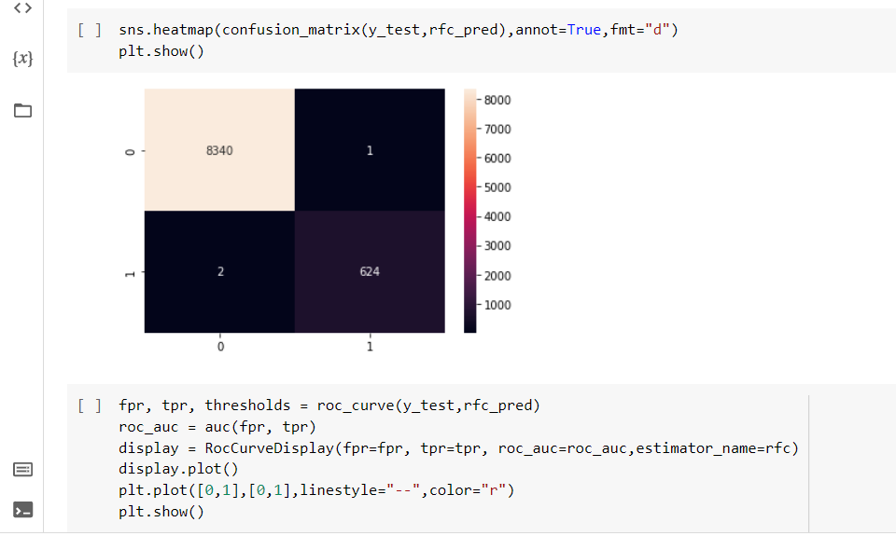
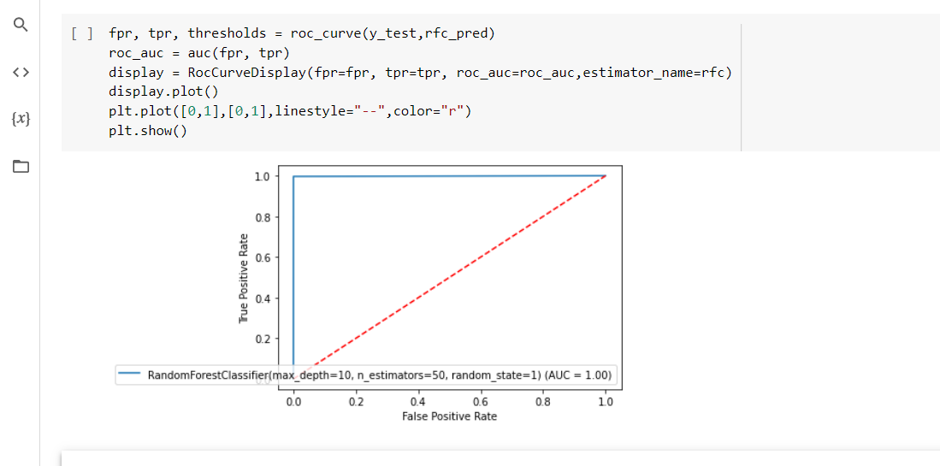
Grid search RANDOM FOREST:

Slide 24
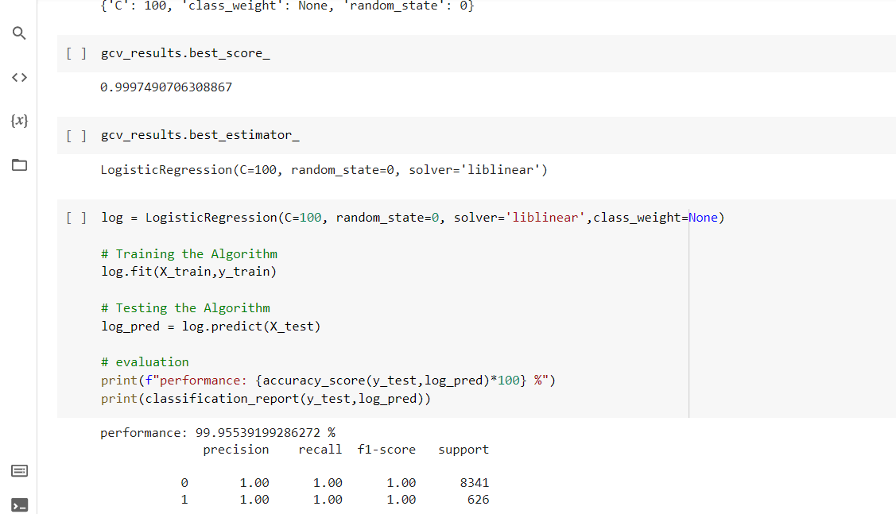
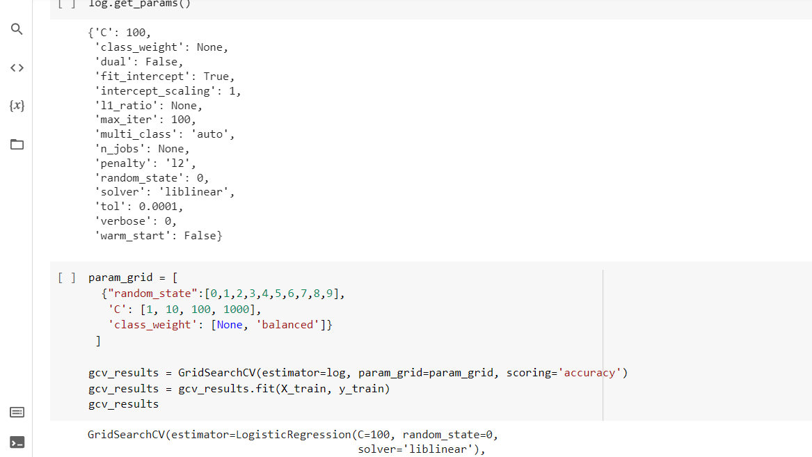
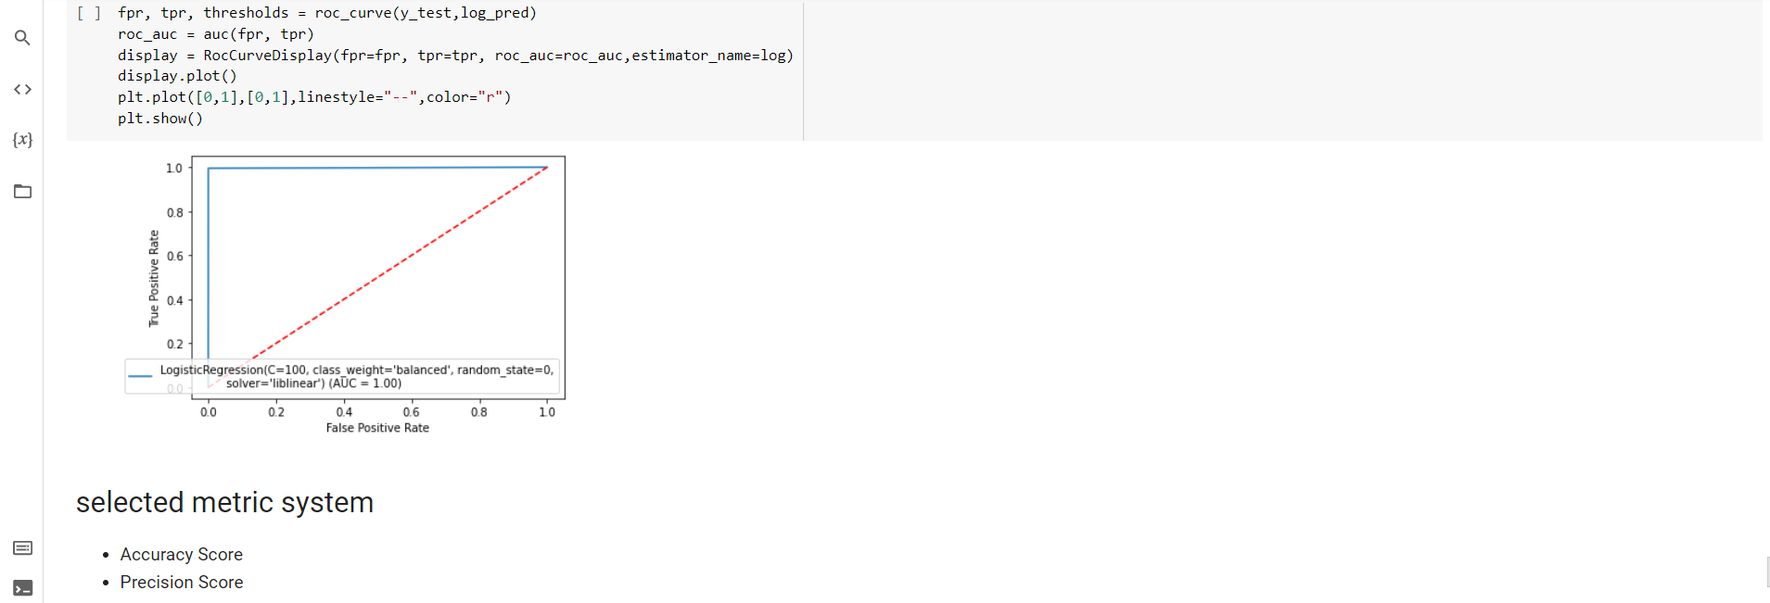
Logistic regression:

Slide 25
selected metric system: Accuracy Score Precision Score Recall f1-Score Confusion Matrix ROC curve out of all the above metrics, 'accuracy' helped the most in many cases like Decision tree, Random Forest, Logistic Regression where rest of the metrics like Recall, F1-score, precision were are 100% except for SVM Algorithm. Confusion matrix and ROC curve helped to understand the model better.

Slide 26
Results we were able to classify the instances as having a hearing or not having with a very good performance of 99.96+ % even when there were few outliers were left in the data. Random Forest was best and decision tree, Logistic Regression was also performing close to best and SVM had many difficulties in classification as it is sensitive to the outliers.
Next steps:
we have only considered a sample data from the population. for the complete data the procedure for data pre-processing may change
all the outliers were not removed, few were left in the dataset. further understanding of the data in better way is possible.
much better algorithms can be researched on that can handle the outliers like voting classifier.
research can be done in finding a better representative sample. for training, validation and testing purposes by understanding the distributions of different random sample. And etc.

Slide 27
References:
1. https://medium.com/swlh/top-five-methods-to-identify-outliers-in-data-2777a87dd7fe
2. https://towardsdatascience.com/feature-selection-correlation-and-p-value-da8921bfb3cf

Slide 28

THANKYOU
ANY QUESTIONS?

